Slide 1
Azure Kubernetes Service
Lecturer: Ngo Huy Bien
Software Engineering Department
Faculty of Information Technology
VNUHCM - University of Science
Ho Chi Minh City, Vietnam
nhbien@fit.hcmus.edu.vn

Slide 2

Objectives

Slide 3

Contents

Slide 4

References
Shimon Ifrah (2024). Getting Started with Containers in Azure. Apress.

Slide 5
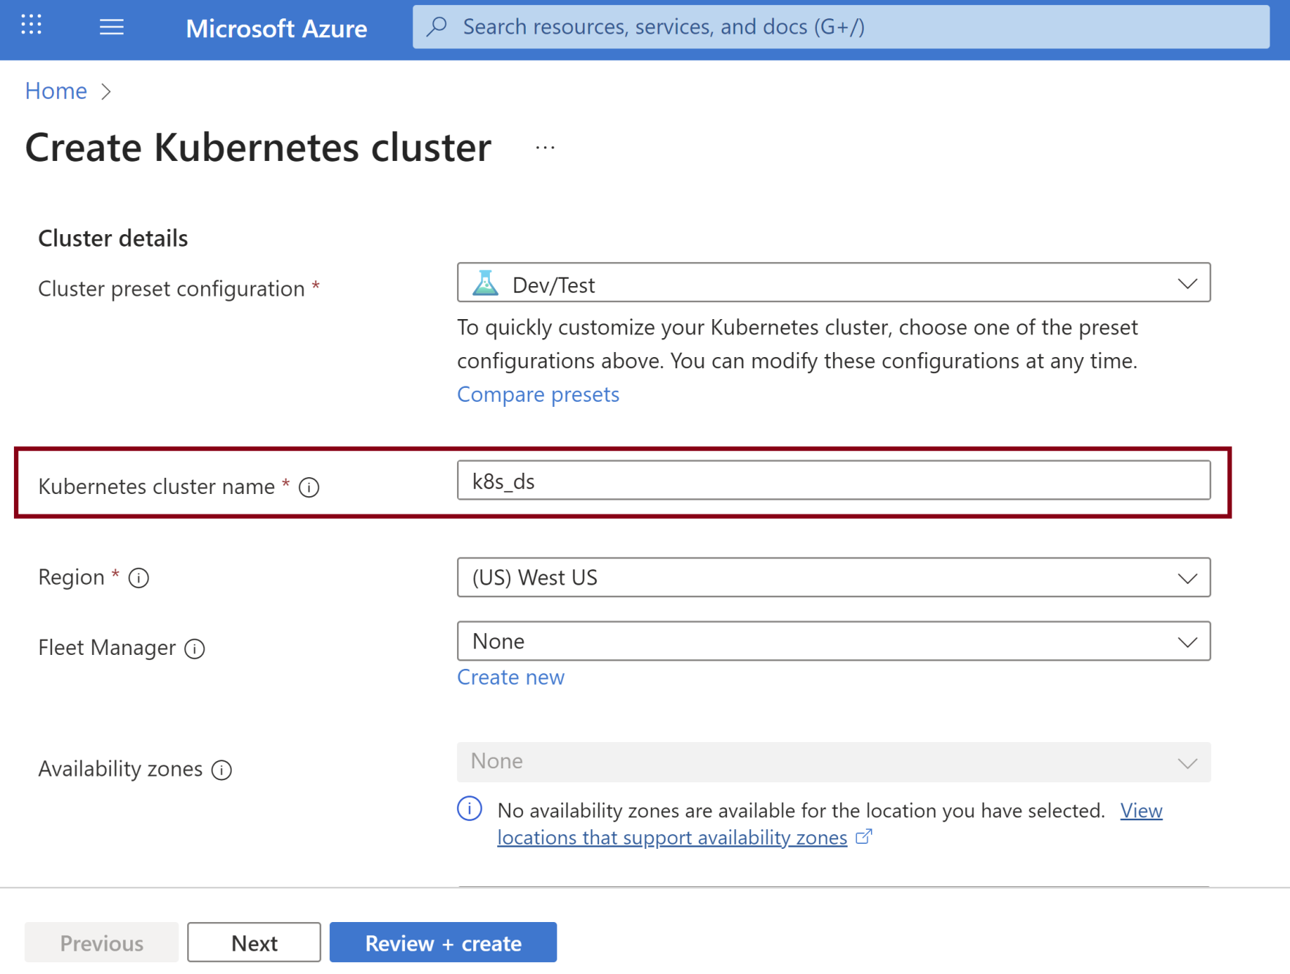
1. Create Cluster

Slide 6
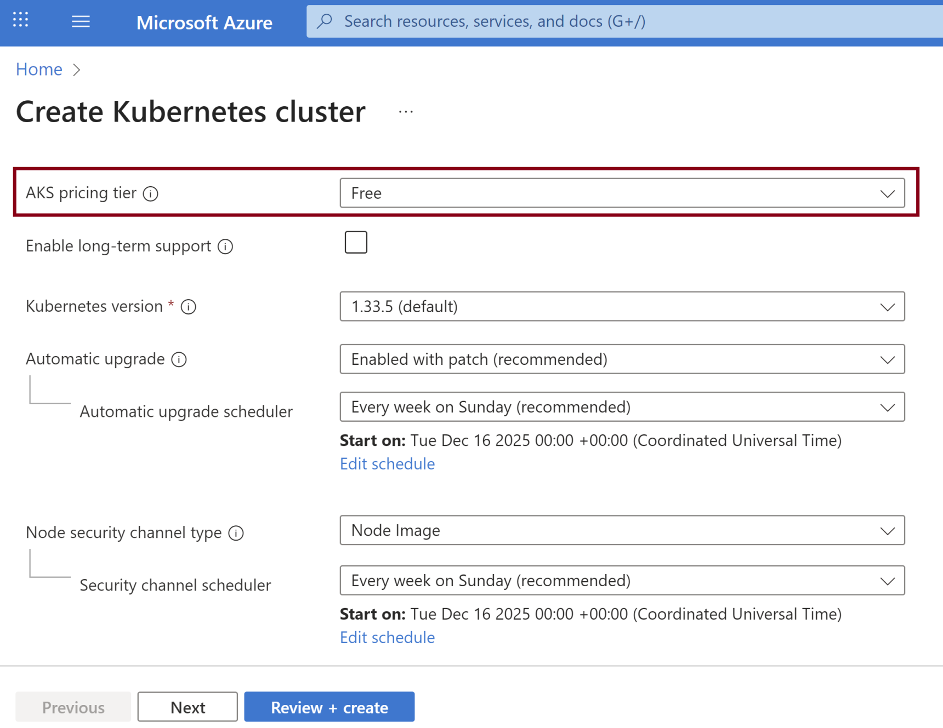
2. Select Pricing Tier

Slide 7
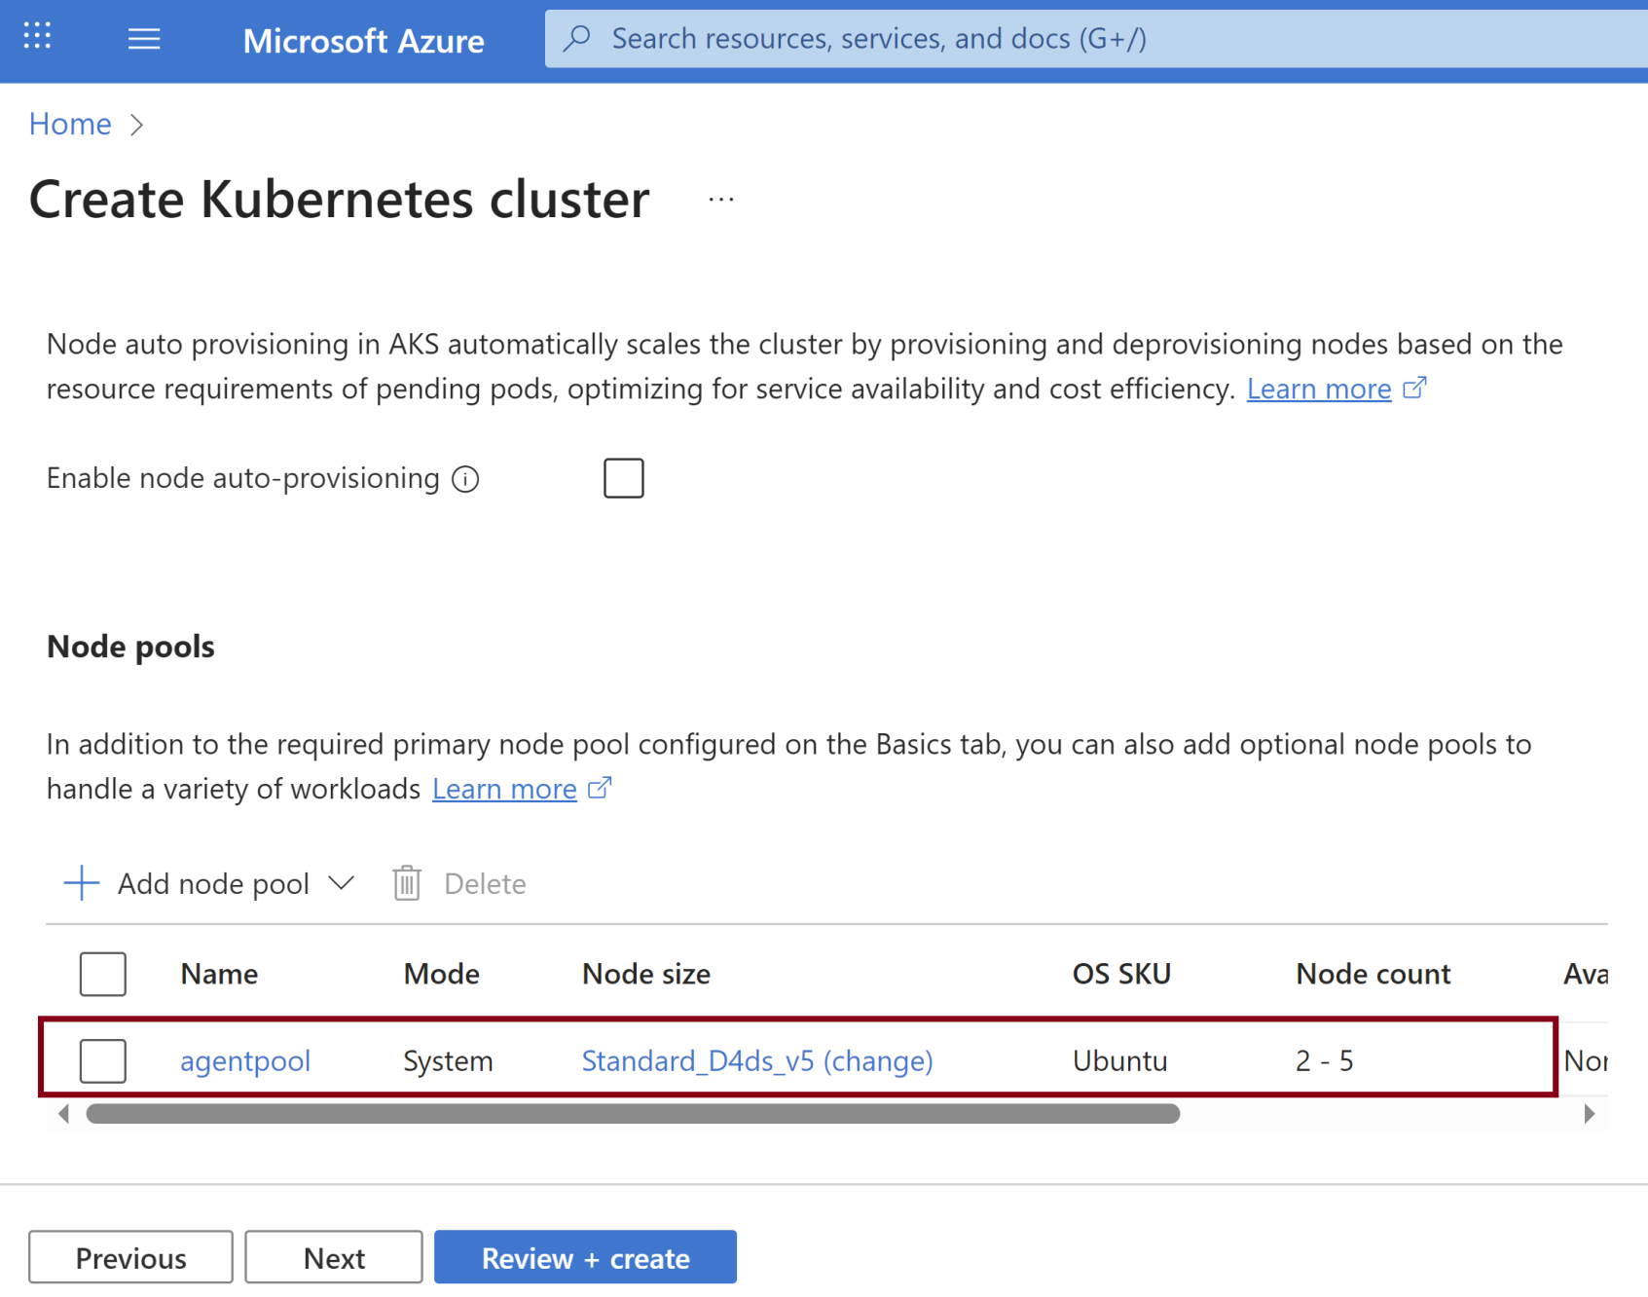
3. Review Default Node Pool

Slide 8
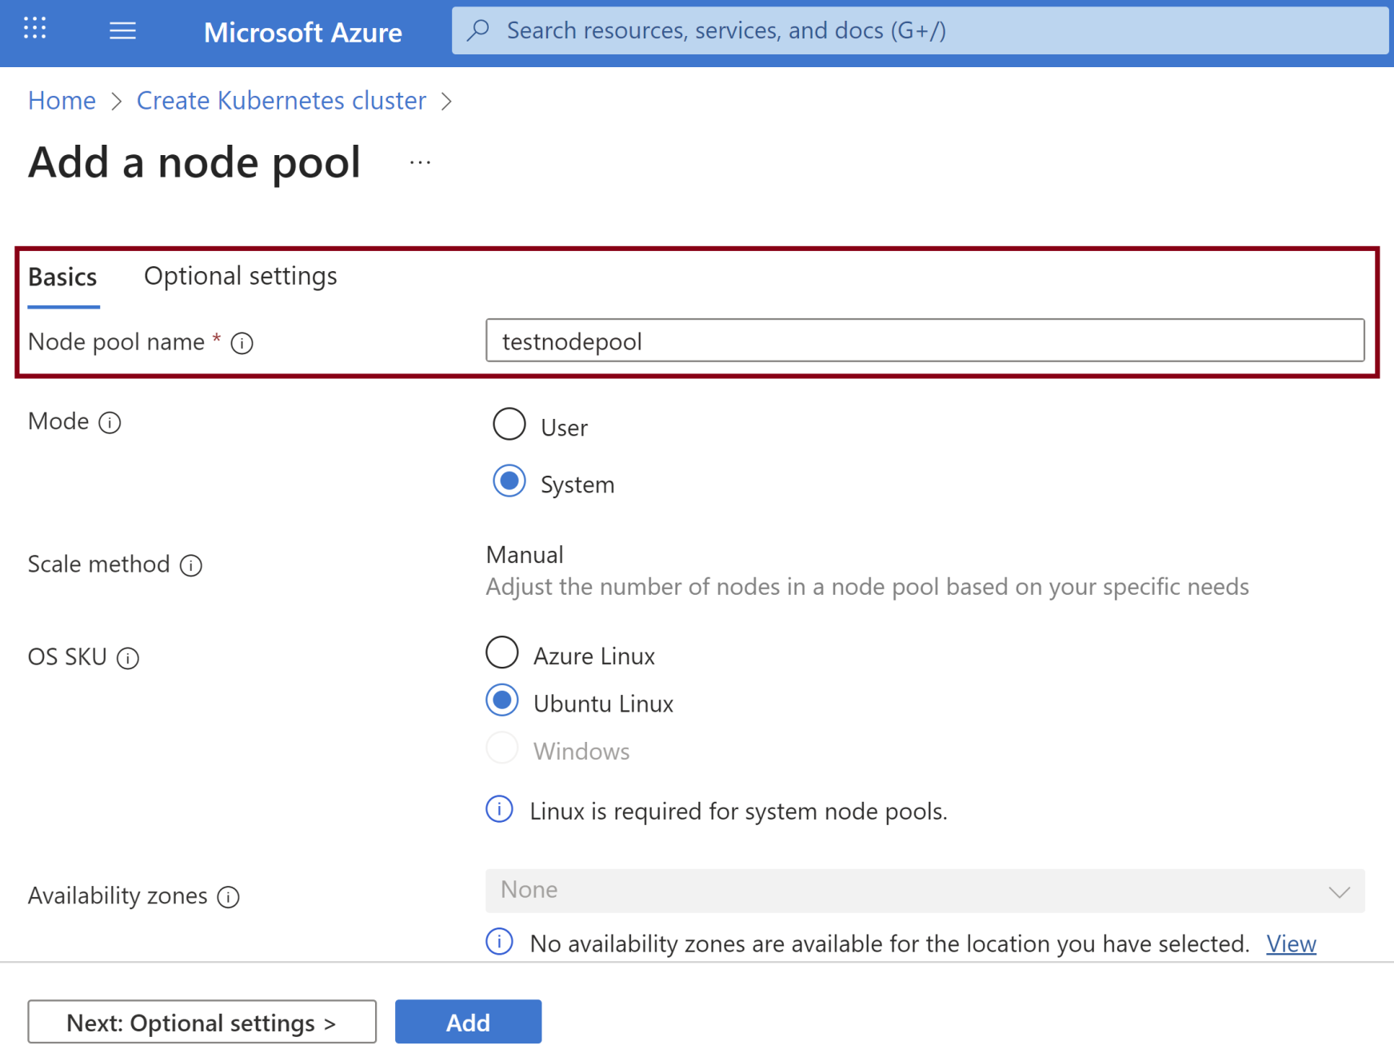
4. Create a New Node Pool

Slide 9
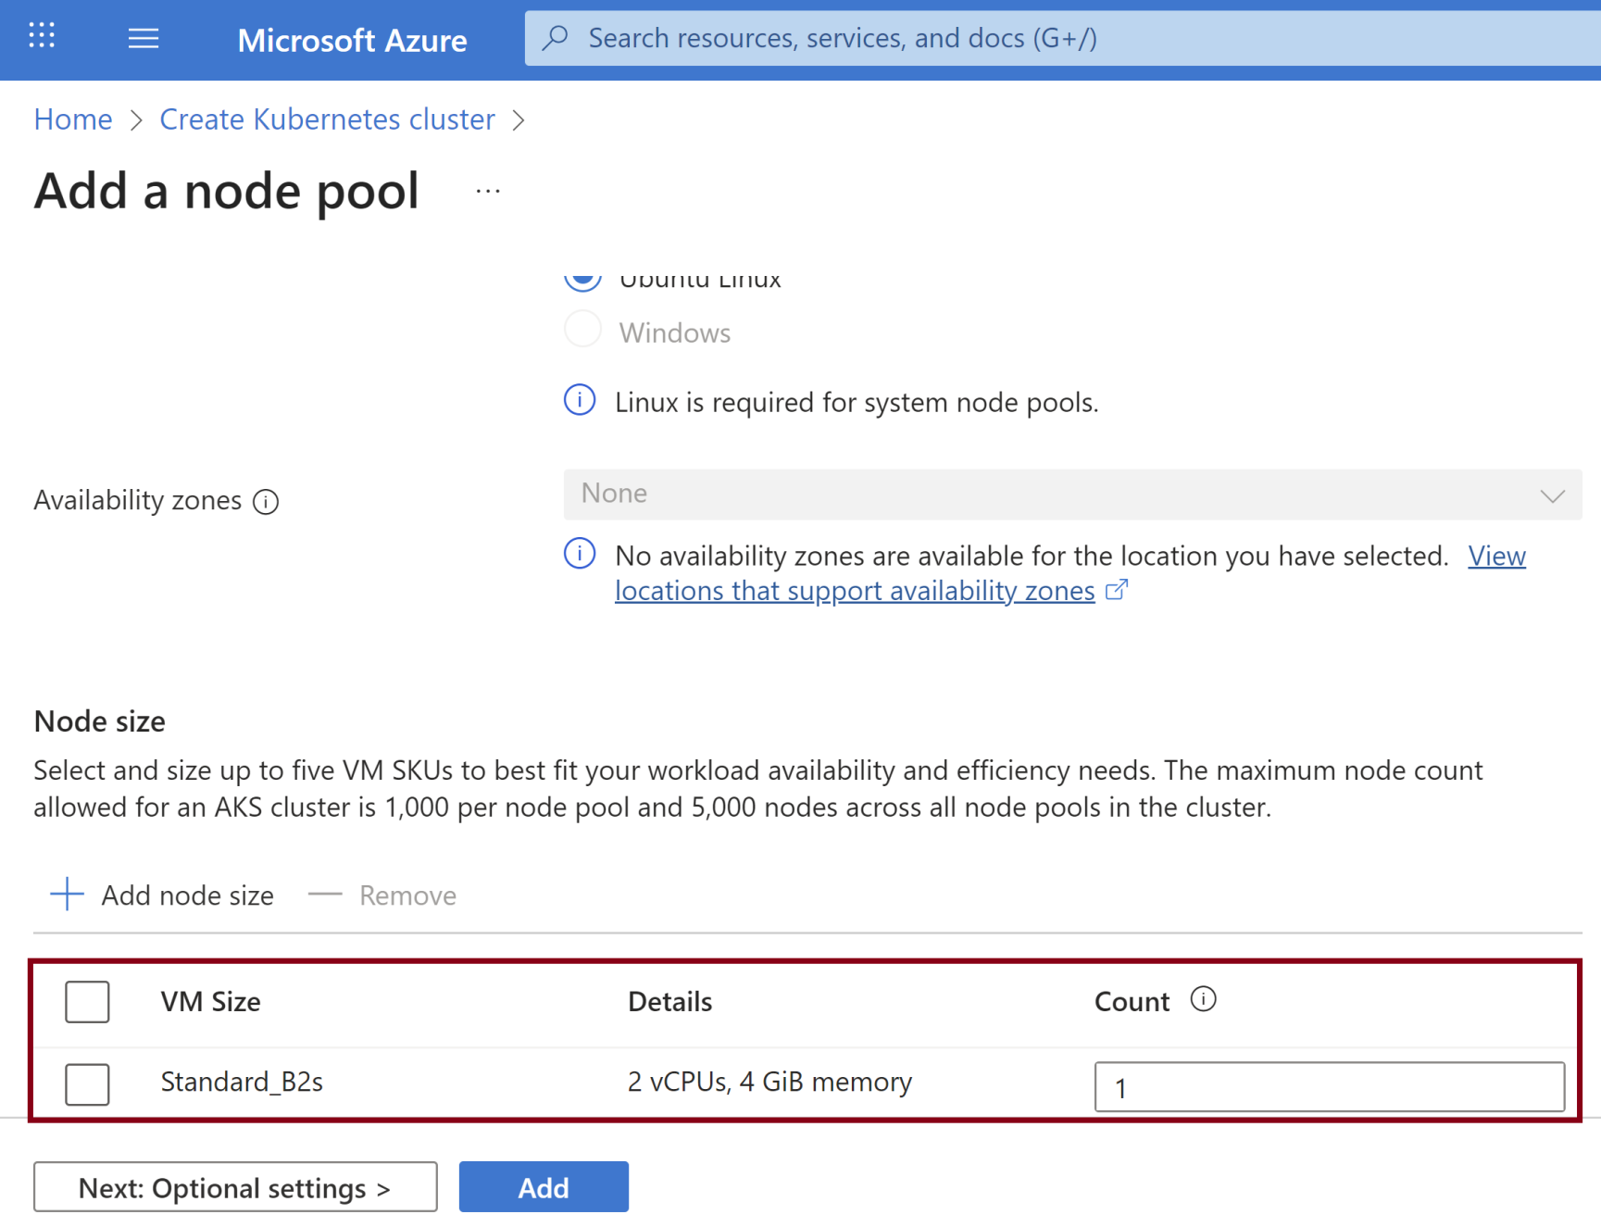
5. Select the New Node Pool Size

Slide 10
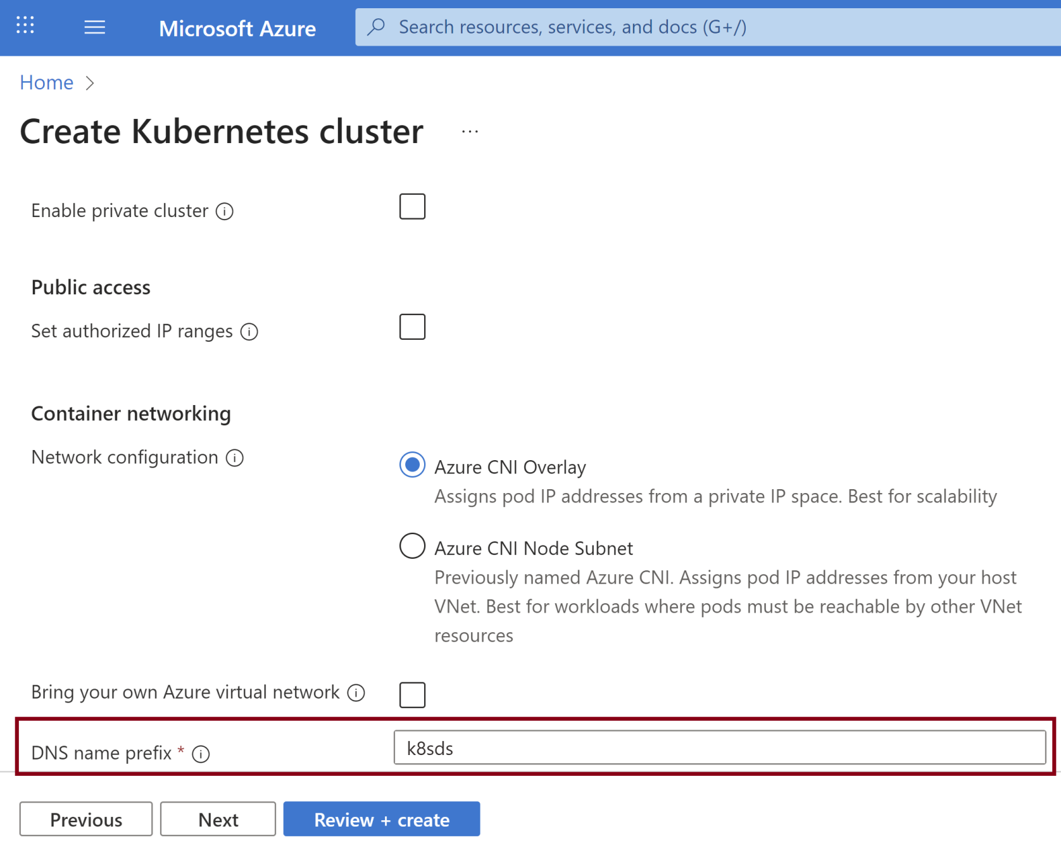
6. Configure Networking

Slide 11
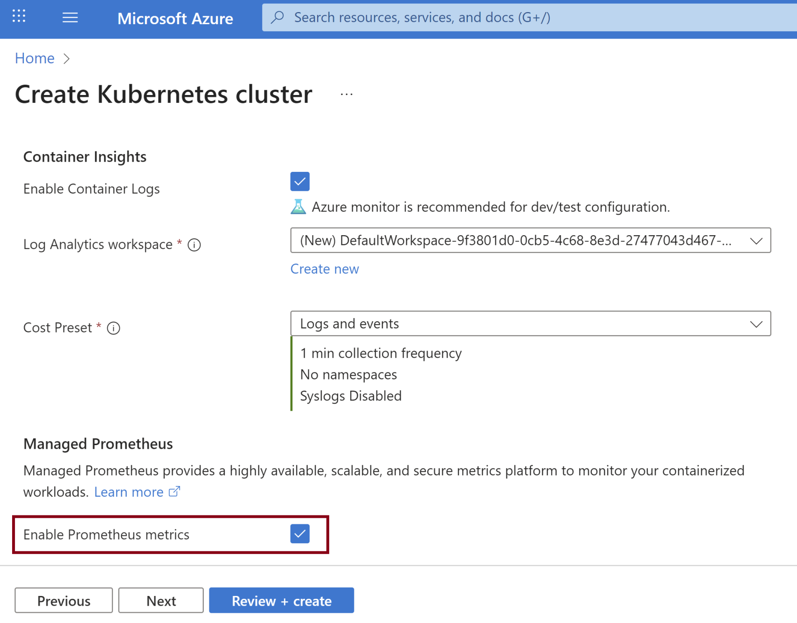
7. Select Integration

Slide 12
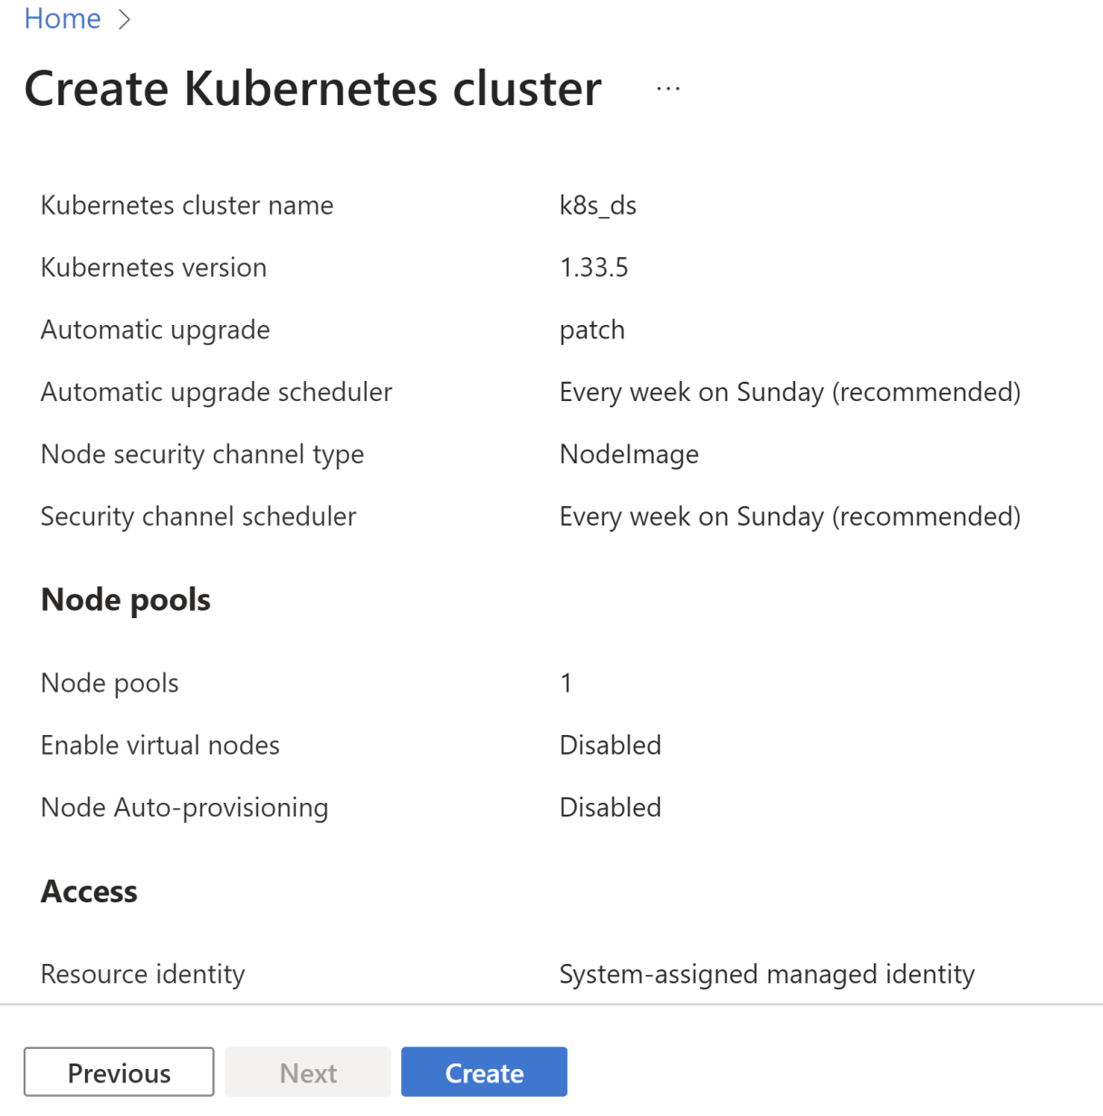
8. Confirm and Create the Cluster

Slide 13
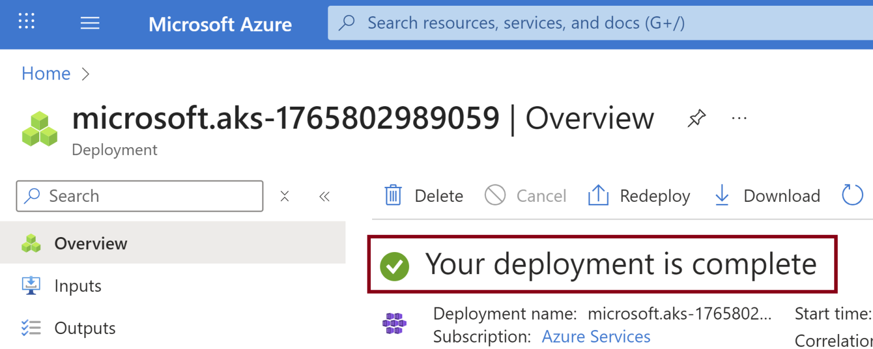
9. Review the Successful Deployment

Slide 14
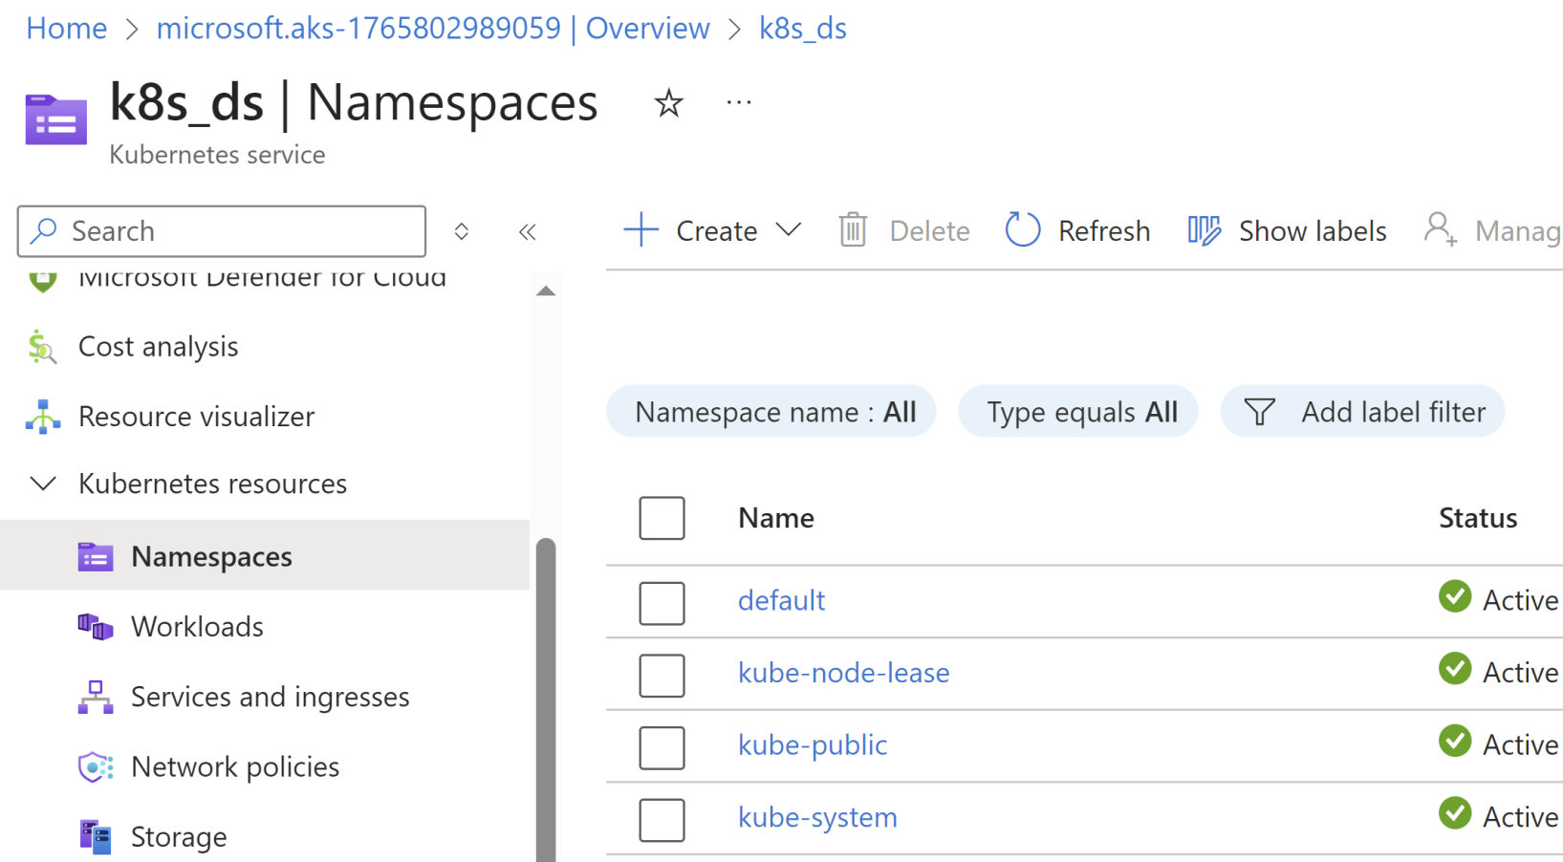
10. Review the Namespaces

Slide 15


Slide 16
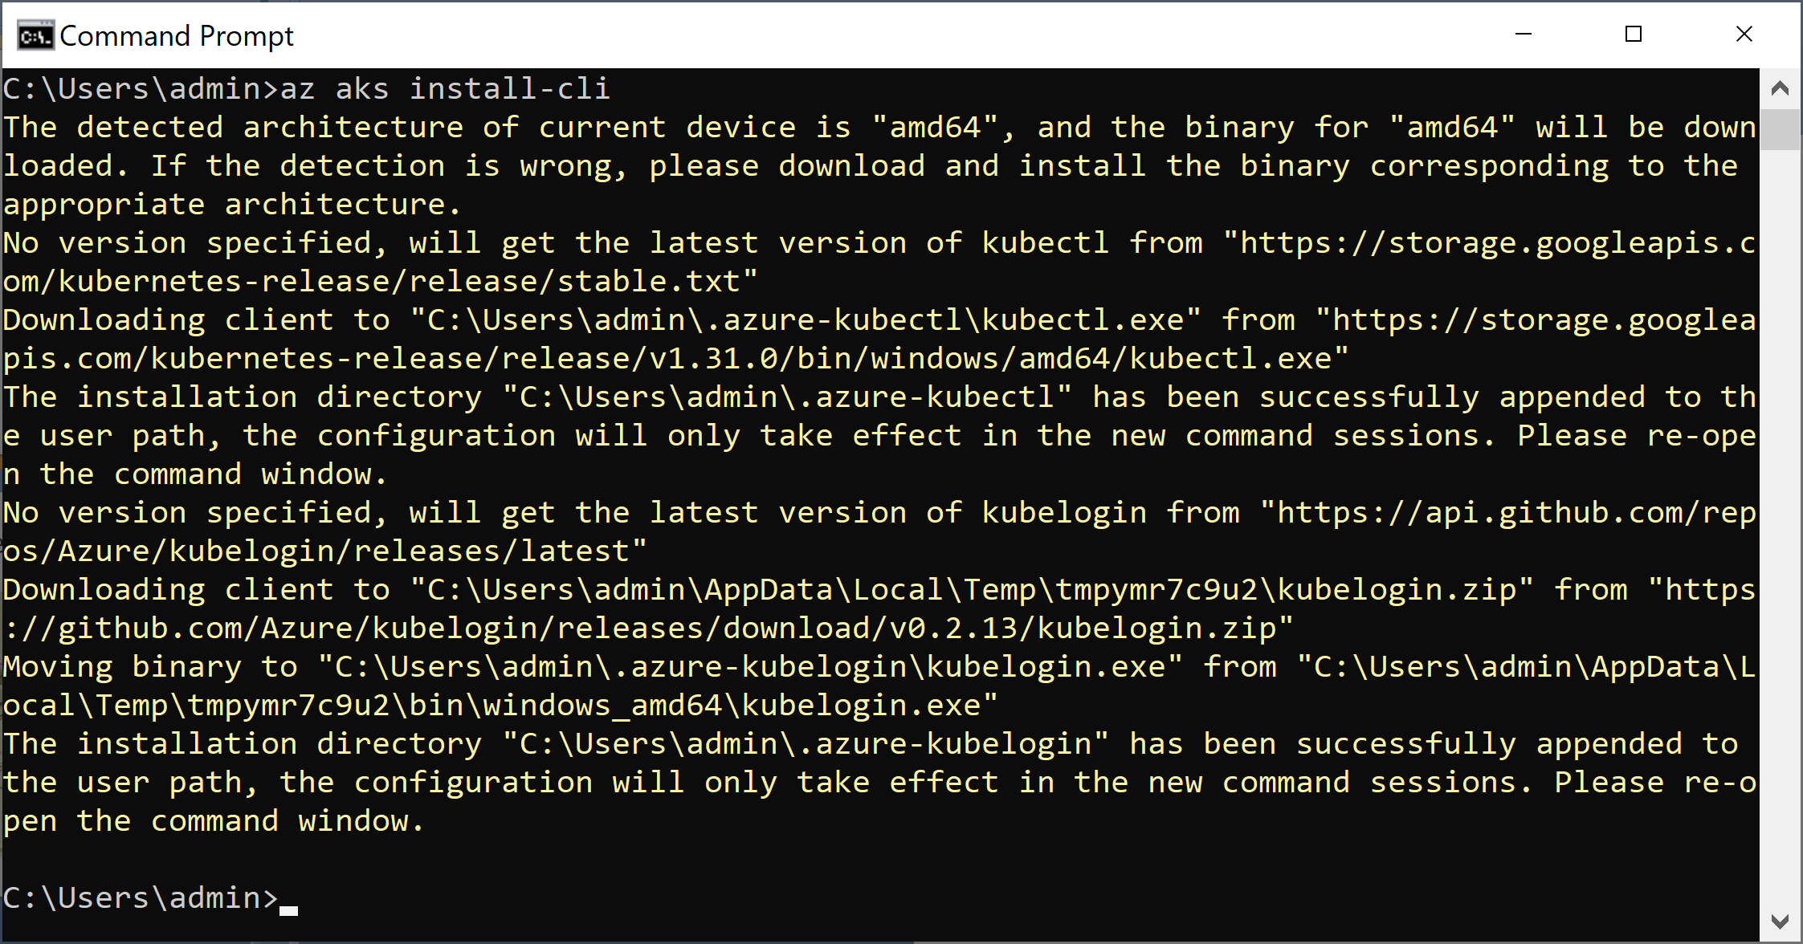
1. Install kubectl on Windows [1]
az aks install-cli
# Wait for 5 minutes.

Slide 17
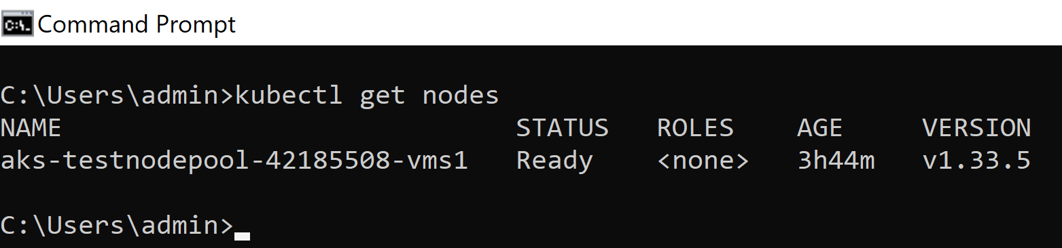
2. Configure and Test kubectl
az login
az account list --output table
az account set --subscription 9f38**467
az aks get-credentials --resource-group d**N --name k8s_ds
# Close the terminal window.
kubectl get nodes

Slide 18
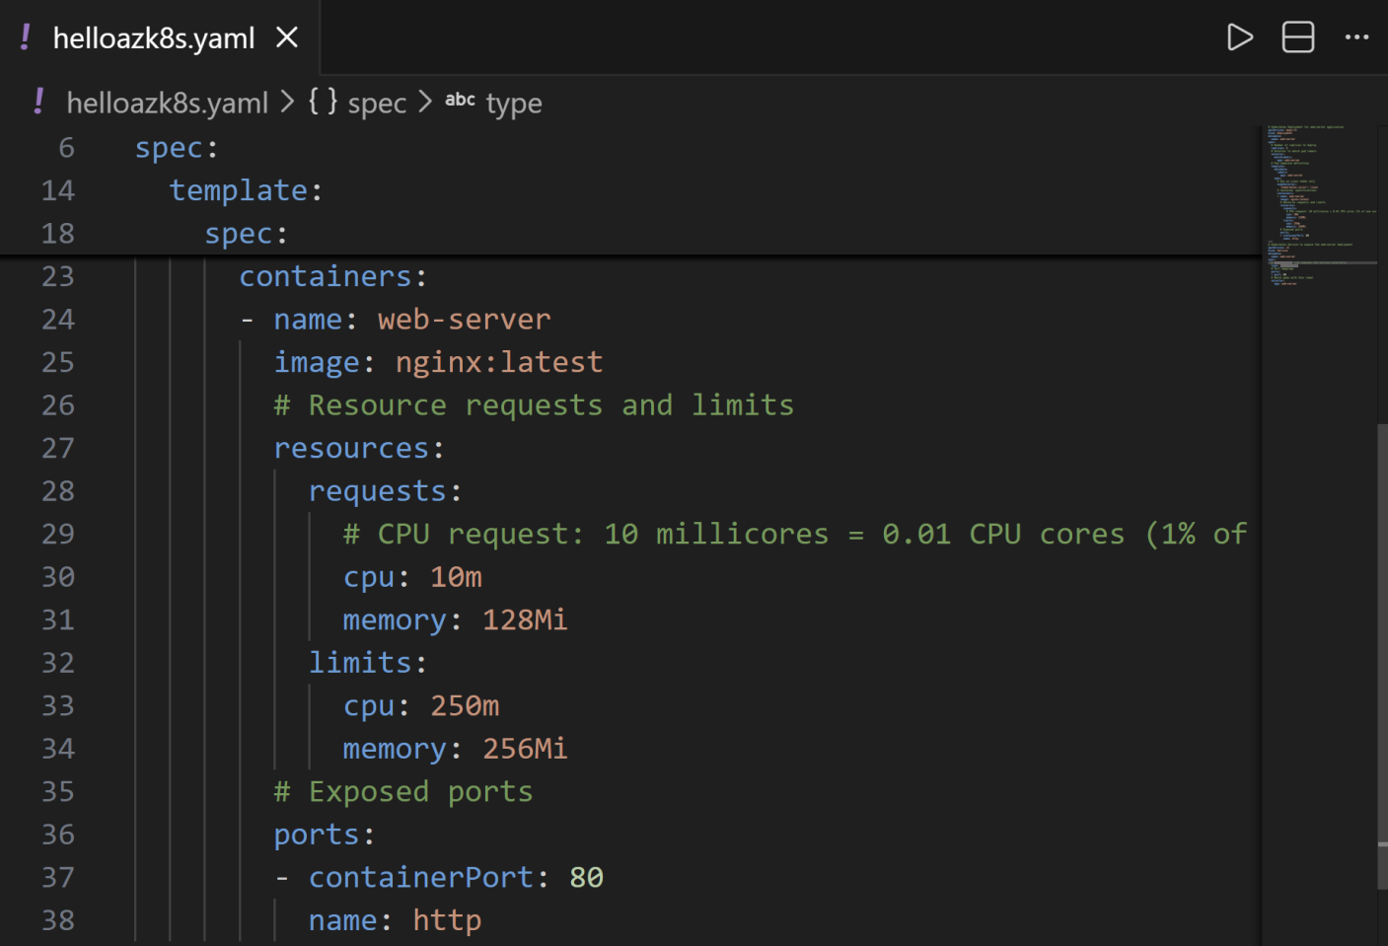
3. Create a Manifest File

Slide 19
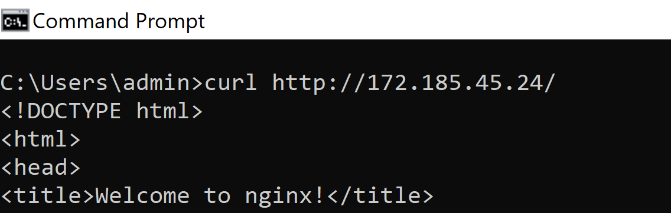
4. Apply the Manifest File
kubectl apply -f helloazk8s.yaml
kubectl get po
kubectl describe pod web-server
# Issue: Insufficient CPU. Solution: Reduce the CPU allocation.
kubectl get service web-server
curl http://172.185.45.24/
# kubectl delete -f helloazk8s.yaml

Slide 21
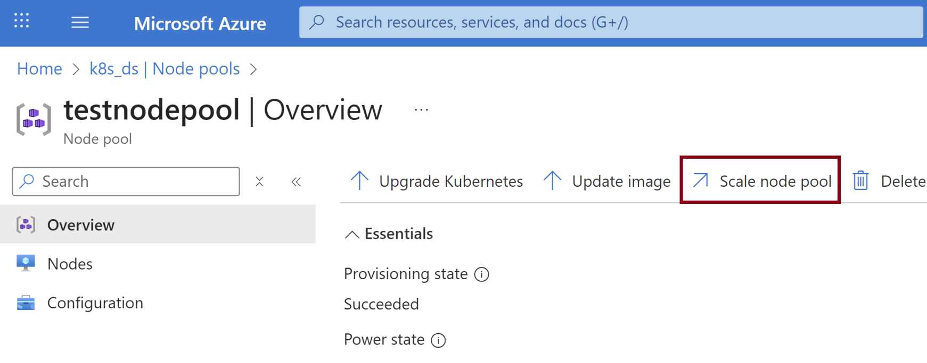
1. Scale Node Pool

Slide 22
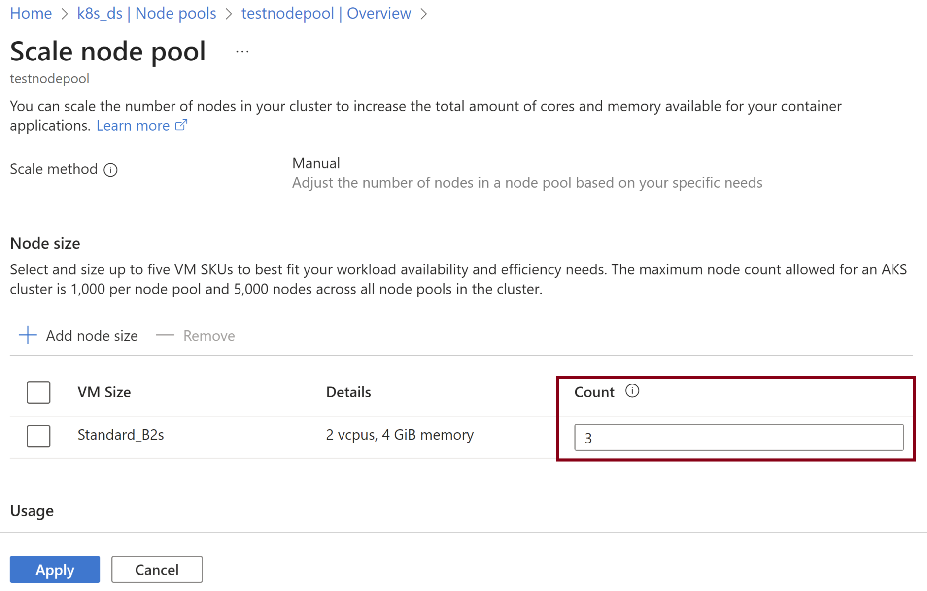
2. Select Node Count

Slide 23

Thank You & See You Again

